Slide 1
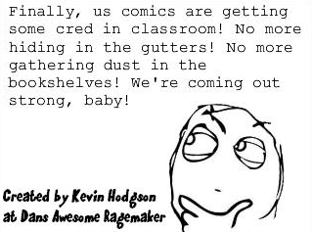
http://graphicnovelsandhighschoolenglish.com

Slide 2
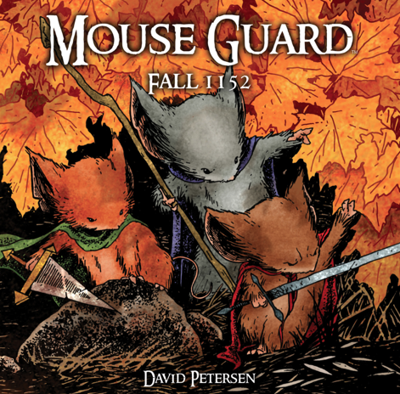
It’s More Than Just A Comic…
Using Graphic Novels to Engage Readers of All Levels
Anita C. Gonzalez
The Ohio Resource Center
English Language Arts Specialist
Doctoral Candidate-OSU
Notes:
One of my candidacy exam questions was related to a review of research on graphic novels and classroom instruction.

Slide 3
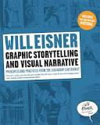
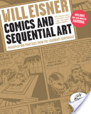
Will Eisner 1917-2005
Coined the terms “graphic novel” and “sequential art”
Notes:
was an American cartoonist, writer, and entrepreneur. He was one of the earliest cartoonists to work in the American comic book industry, and his series The Spirit (1940–1952) was noted for its experiments in content and form.
A contract with God
Graphic storytelling 1996
Comics and sequential art 2008

Slide 4
Defining the Graphic Novel
Notes:
What is a graphic novel?
We hear the term graphic novel and and then we hear others like ‘graphica’ and then I think of other texts like those from author Gail Gibbons and wonder, are those graphic novels? Maybe those should be called graphic texts. So, we’ll start with sharing information on defining the graphic novel.

Slide 5
Powerful definitions of successful graphic novels include one argued by Gallo & Wiener (2004) stating:
“A well-done graphic novel offers the immediacy of the prose reading experience, with the pictures and the words working simultaneously, making a graphic novel not only something one reads but something one sees as well, like reading and watching a movie at the same time” (p. 115).
Notes:
McTaggart says it best by stating, “While all graphic novels are comics, not all comic books are graphic novels” (2008, p. 31).

Slide 6
Baird & Jackson (2007) offer another strong definition of a winning graphic novel:
“A successful graphic novel starts with a stellar story told with words and pictures that augment the story, providing insight that text alone cannot do” (p. 5).
Notes:
There were several other definitions including those that mentioned the physical differences between comics and novels-We know it’s a comic book when we see a magazine-like publication, 28 page length, stapled spines, etc. Some researchers defined graphic novels as texts that physically look like books with beginning, middle and end stories-similar to a picture book. And then I thought about, well, what’s the difference between a graphic novel and a picture book? Ahhhh
As I tried to define graphic novel, I read work by Scott McCloud

Slide 7
Scott McCloud
“Our attempts to define comics are an on-going process which won’t end anytime soon” (1994, p. 23).
Notes:
As I tried to define graphic novel, I read work by Scott McCloud. Scott McCloud is an American cartoonist and comics theorist. He is best known for his non-fiction books about comics, Understanding Comics, Reinventing Comics, and Making Comics
And he said this…
And this is how I feel about graphic novels. Attempts to define this category of text is on-going and as books continue to break the traditional novel or storybook mold, defining graphic novel will be an on-going process. But as educators, I think its important that we are thinking about this and because of the popularity of graphic texts, we should keep thinking about these texts and how we can use them in the classroom in effective ways.
As long as authors continue to break the literature molds, the definition will probably always lack clear lines

Slide 8
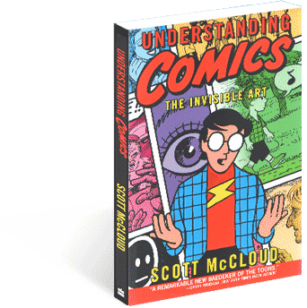
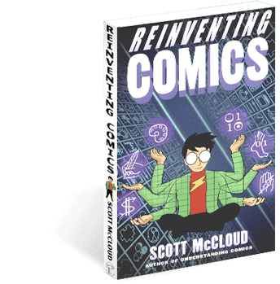
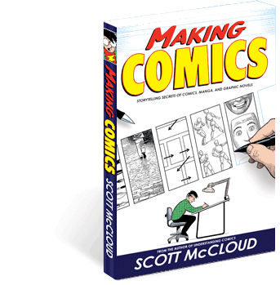
Notes:
3 of the most popular resource books by Scott McCloud
When learning about how to teach graphic texts in the classroom, we draw on the expertise of comic experts.

Slide 9
Where I am now with my definition of a graphic novel:
“A graphic novel is what we think of when we say a ‘novel’, yet told in comic illustration form with the pictures and the text working together
to tell the story.”

Slide 10
What is ‘Graphica’ ?
Notes:
When I first read the term graphica, the piece of research used the term to collectively define comics and graphic novels. But after my candidacy defense, I learned from one of my committee members that any text with comic like illustrations and text that work together to send a message or tell a story or give information can be considered graphica.

Slide 11
The Rise of the Graphic Novel
Thank you Librarians!

Slide 12
Graphic Novels
and
Classroom Instruction

Slide 13
Category vs. Genre
“To be seen as an isolated genre is detrimental to the integration of graphic novels into classroom curricula.”
(Gonzalez, 2013)

Slide 14
Teaching “Codes” of the Graphic Novel
Panels
Gutters
Bleed
Frame
Speech bubbles
Thought balloons
Sequential art
Layout

Slide 15
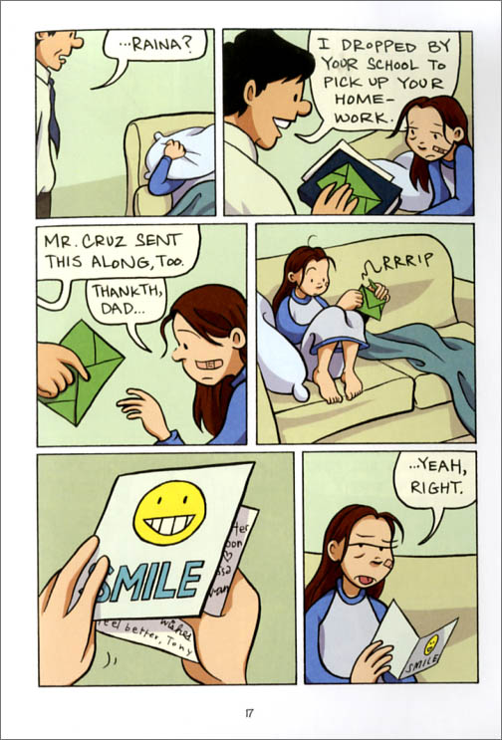
Speech bubbles
Panels
Frame
Gutter

Slide 16
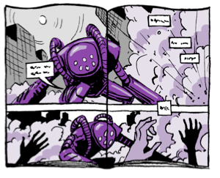
Bleed

Slide 17
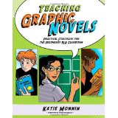
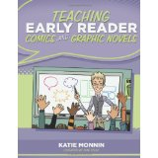
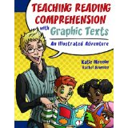
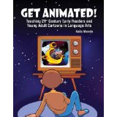
Teaching Resources by Katie Monnin

Slide 18
Graphic Novels as Multimodal Texts
A multimodal text can be paper, digital or live using a combination of ‘modes’ such as images, movement, sound, spatial design, gestures and language.
http://creatingmultimodaltexts.com
Notes:
One of my arguments for using graphic novels in the classroom is related to the idea of multimodal texts. read about this idea of multimodality and think about all of the tech devices children are using, it seems logical that they would be able to learn if not easily catch on with little instruction how to read a graphic novel.
in a multimodal interaction a user may receive information by vision and sound and respond by voice and touch.
Smart phones, ipads, tablets, new generation of video games

Slide 19
Literary Thinking and Learning
“Combining visual art (a sense of space, mass, motion and color) with literary and cinematic techniques (plot, point of view, character development, metaphor, allegory, flashbacks and flashforwards, speeding and slowing time, close-ups, long views, stream of consciousness, montage, etc.) graphic novels contain some of the most creative work in publishing today (p. 2).”
(The National Coalition Against Censorship (NCAC),
The American Library Association (ALA) and
The Comic Book Legal Defense Fund, 2006)

Slide 20
Literary Thinking and Learning
Characterization
Plot
Setting
Point of View
Inference
Metaphor
Allegory
Flashback
Flashforward
Language
Theme
Protagonist
Puns
Alliteration
Along with elements of art:
Space
Mass
Motion
Color
Texture
Line
Notes:
Its in the gutters and panel format where inferring happens

Slide 21
“Whoever said that a comic book is a quick read has never actually read a comic before, not properly at least.”
Elizabeth Heyman-Senior
Watchung Hills Regional High School
Warren, New Jersey
www.graphicnovelreporter.com 2012.

Slide 22
Literacy Standards and Graphic Novels
CCSS.ELA-LITERACY.RL.5.7
Analyze how visual and multimedia elements contribute to the meaning, tone, or beauty of a text (e.g., graphic novel, multimedia presentation of fiction, folktale, myth, poem).
Notes:
Treat graphic novels and texts just the same as a typical book in terms of using to teach the standards

Slide 23
Research Using Graphic Novels in the Classroom
“The Studies”
Notes:
One of my arguments for using graphic novels in the classroom is related to the idea of multimodal texts. read about this idea of multimodality and think about all of the tech devices children are using, it seems logical that they would be able to learn if not easily catch on with little instruction how to read a graphic novel.
in a multimodal interaction a user may receive information by vision and sound and respond by voice and touch.
Smart phones, ipads, tablets, new generation of video games

Slide 24
Study 1
Exploring literary devices in graphic novels
-Dallacqua, 2012
In what ways do readers engage while reading a graphic novel?
“Literary devices are not only present, but recognizable to the students of this study with no prompting from me” (Dallacqua)

Slide 25
Study 2
Graphic novels in the classroom: Curriculum design, implementation and reflection-Schmidt, 2011
Could graphic novels increase student interest in reading?
“Researching graphic novels, I have learned that as a teacher, I must remain teachable” (Schmidt)

Slide 26
Study 3
Grade 7 Students Reading Graphic Novels: ‘You need to do a lot of thinking”-Pantaleo, 2011
Does reading graphic novels impact the intrinsic motivation, reading comprehension and vocabulary development of 7th graders?
“Through student work, they communicated it’s essential to ‘see’, not merely to look” (Pantaleo)
Notes:
High achievers

Slide 27
Study 4
Graphic novel gurus: Students with learning disabilities enjoying real literature-Smetana, 2012
Can students with learning disabilities enjoy and learn from real literature?

Slide 28
Study 4
“They were participating more in classroom discussions. Their oral language was peppered with new vocabulary and complex sentences. They were recognizing many of the devices that authors use to communicate meaning. As a result of the application of their knowledge and skills, they were making meaning from their reading.” (Smetana)

Slide 29
One more…
Graphic novels: What elementary teachers think about their instructional value
-Lapp, D., Fisher, D. & Frey, N. 2012
“Although study participants did not use graphic novels in substantive ways in most classrooms, they did indicate overall the possibility that the attributes of graphic novels would make them potentially useful supplements to existing reading materials already in use.”
Notes:
Further,
most participants recognized the possibility that graphica might
serve as important pathways to the critical thinking that they
value for their students. Thus present study findings lend support
for the possibility of additional research, possibly in the qualitative
tradition, to determine if graphica might be instructionally
useful. For example, participant responses as to “When would
graphic novels be useful in instruction?” “How can graphic be used
instructionally?” and “When would graphica not be appropriate
for instruction?” offer questions for study.

Slide 30
Recent Research
Is a Picture Worth a Thousand Words? Determining the Criteria for Graphic Novels with Literary Merit
Michael Pagliaro
English Journal, Vol 103, 4, March 2014

Slide 31
Visual Literacy
The 6th Language Art
Reading, writing, speaking, listening, viewing and visually representing

Slide 32
Visually representing is presenting information through images, either alone or along with spoken or written words.
-NCTE and ILA (IRA)

Slide 33
Visual literacy “might be broadly defined as all of the skills and knowledge needed to decode images and understand, at least on a literal level, the contents of the image”
(Pagliaro, p. 34)

Slide 34
“…if we show kids how the written word actually has a visual component to it…I think they’ll become much better writers”
(Pagliaro, p. 35)

Slide 35
Rubric of Literary Merit in Graphic Novels

Slide 36
Rubric Outline
How to Read a Graphic Novel
Information that reiterates how to read images in a graphic novel
Before Reading
Imaged Based Questions
During Reading
“Read the images and text as separate, equally important elements”
After Reading
Theme and content

Slide 37
Graphic Texts from K-12

Slide 38
Graphic Novel Awards
Cybils
Pulitzer
Printz
Eisner
Eagle
Harvey
Lulu
Lynn Ward
YALSA
ALA
Siebert
Alex Awards
Nick Magazine

Slide 43
Notes:
http://www.toon-books.com/

Slide 44
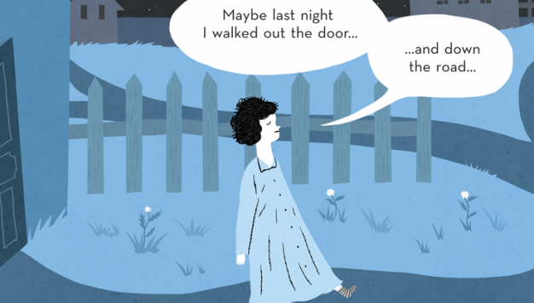

Slide 45
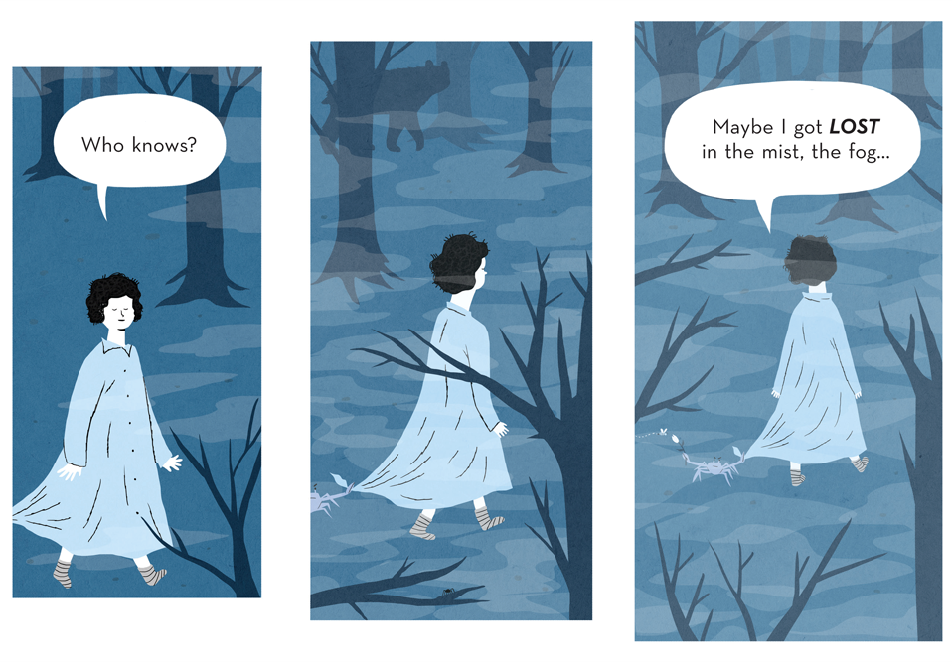

Slide 46
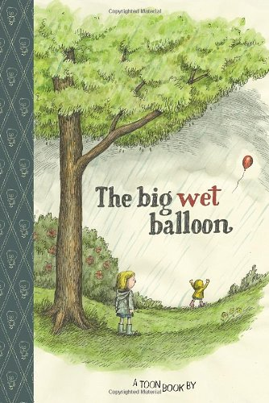

Slide 47
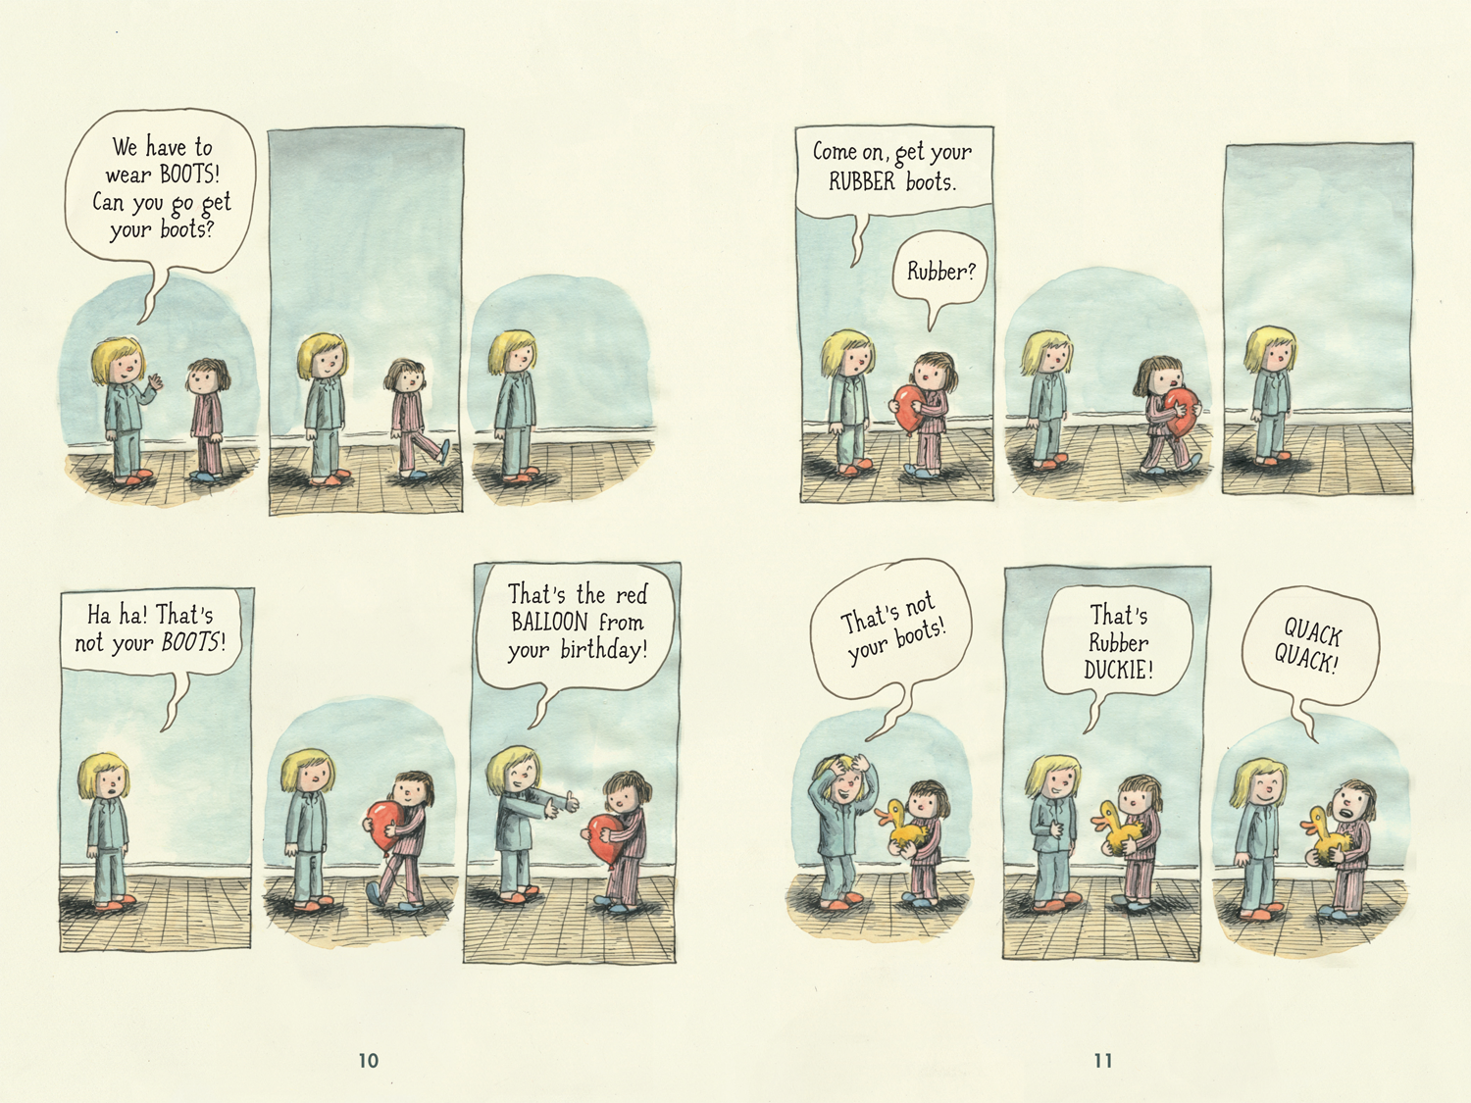

Slide 48
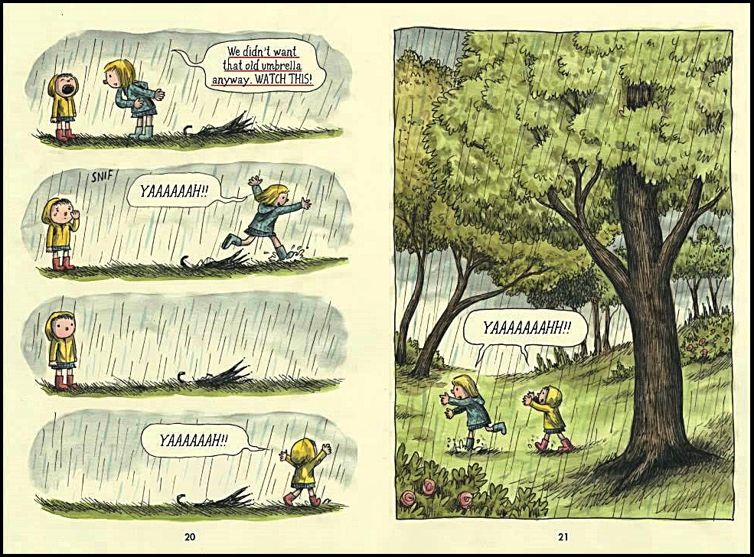

Slide 49
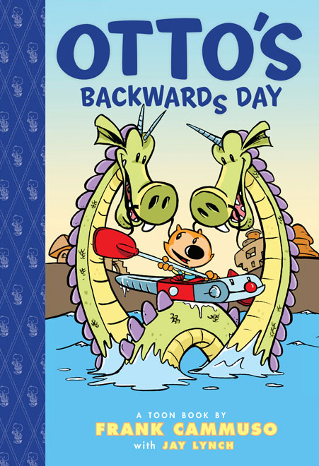

Slide 50
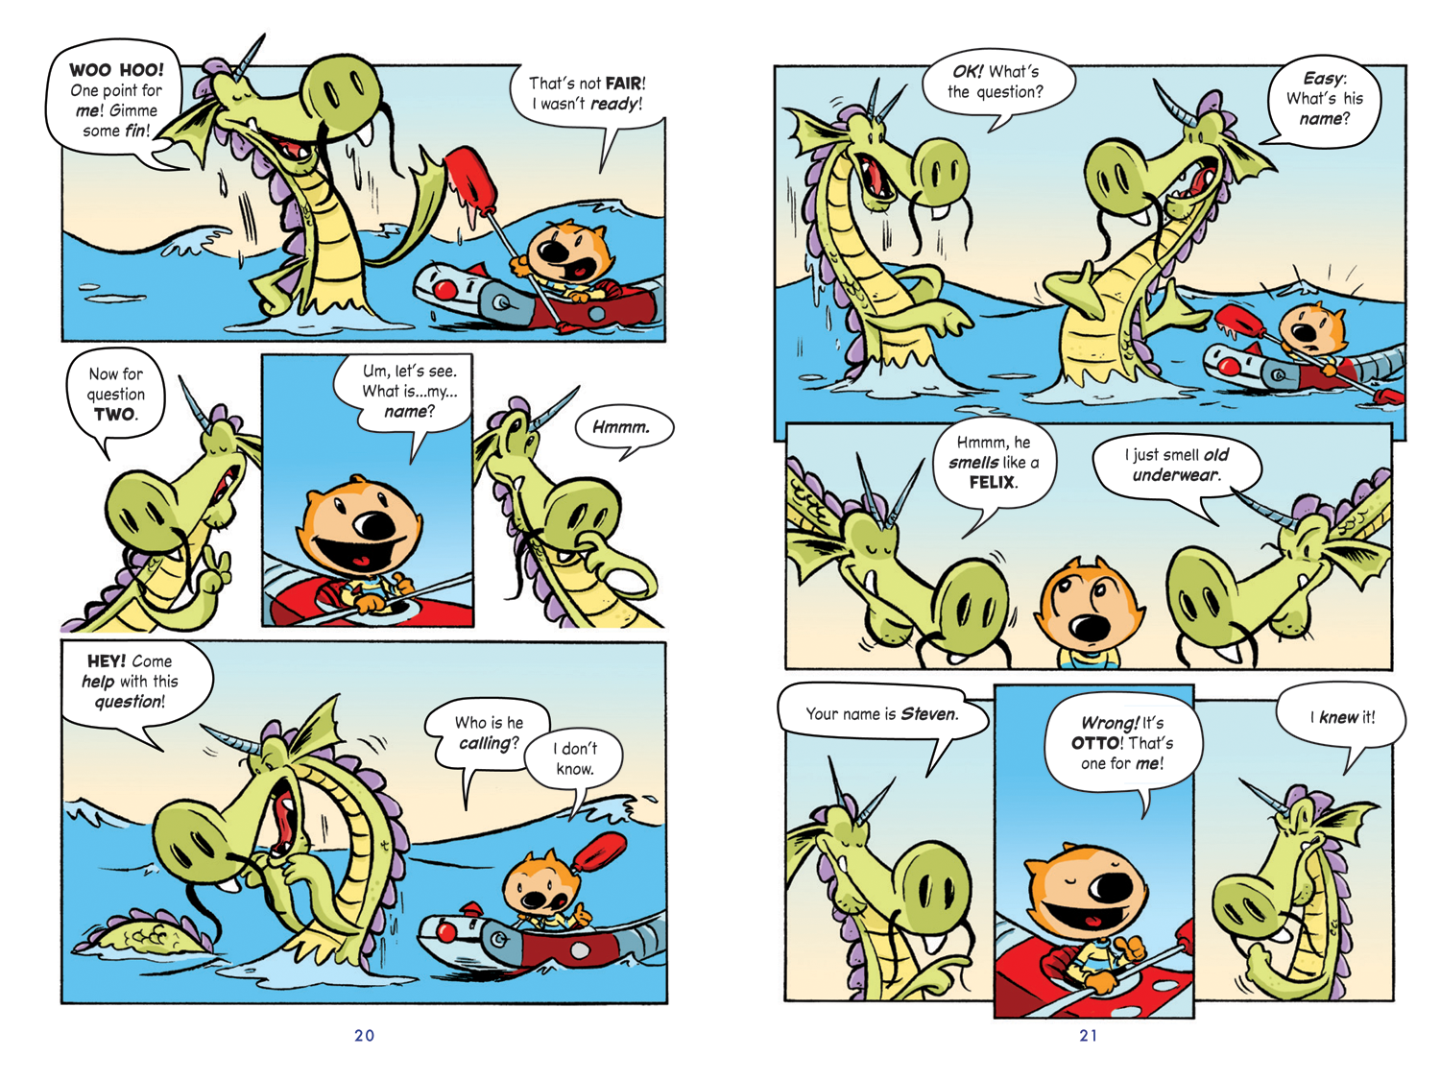

Slide 51
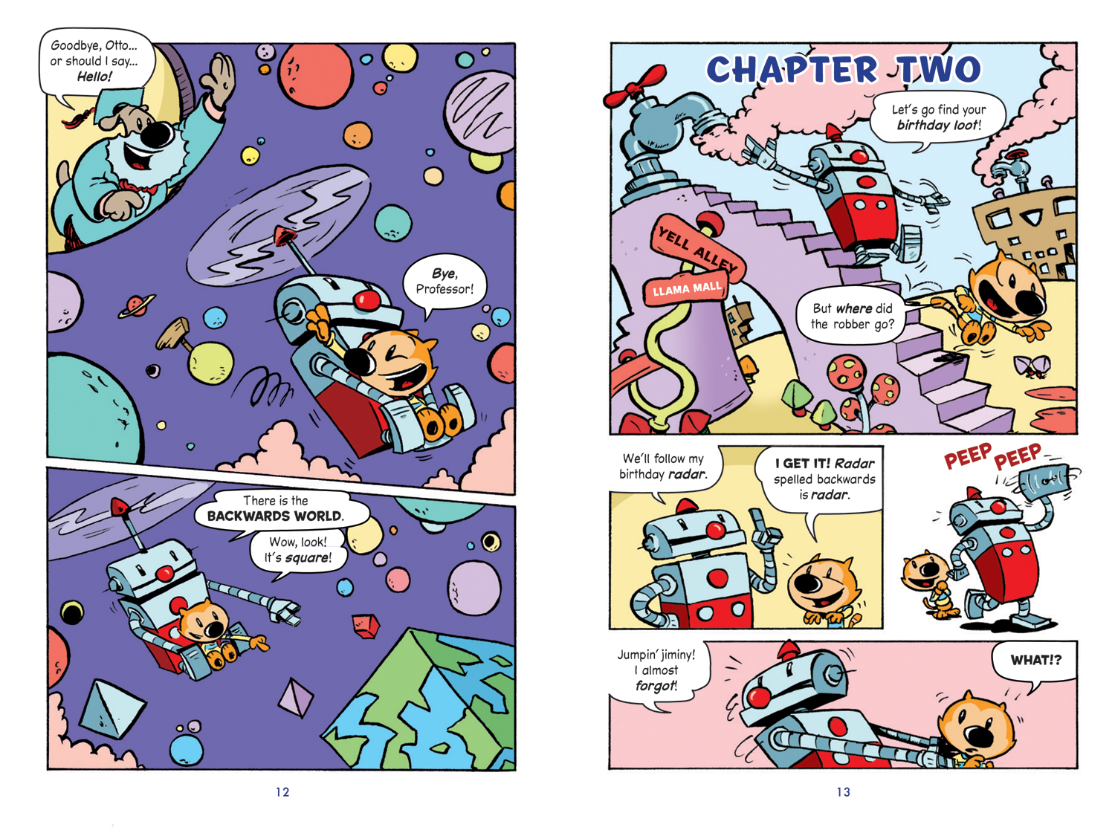

Slide 52
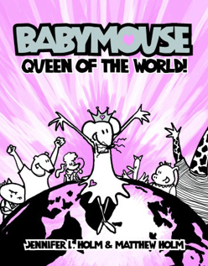

Slide 53
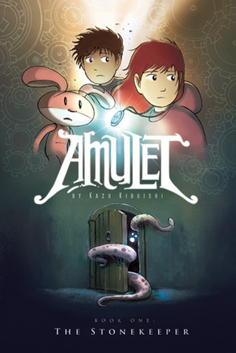
Notes:
Lost children struggling to save their mother who was kidnapped by a beast
Ny times best seller

Slide 54
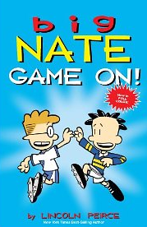
Notes:
Nate is 11 and he lives with his dad and older sister. He has struggles at school and and at home
Series and theres a greatest hits book

Slide 55
Notes:
Coraline and written many award wining books
Also published by TOON
Abandoned by their parents and trying to survive the hungry witch

Slide 56
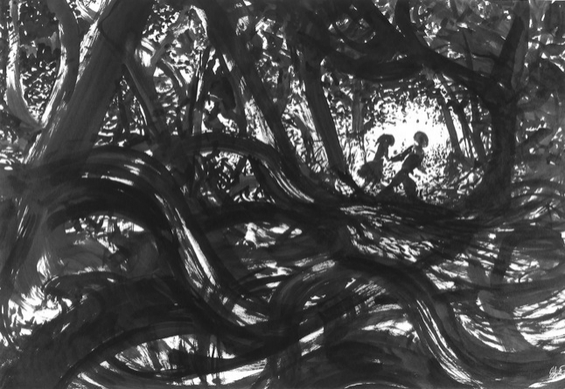

Slide 58
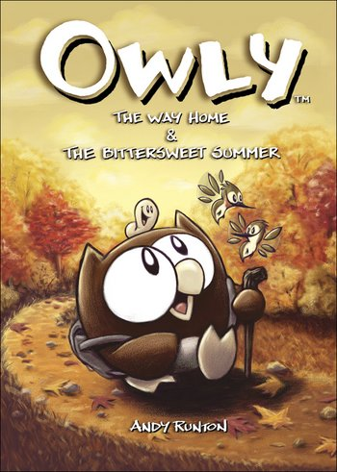
Notes:
Part of a series, no text
Sweet owl that’s often lonely and looking for new friends and adventure

Slide 59
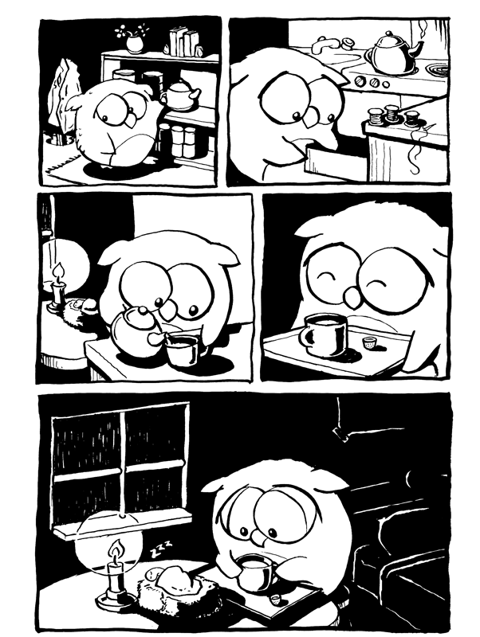

Slide 60
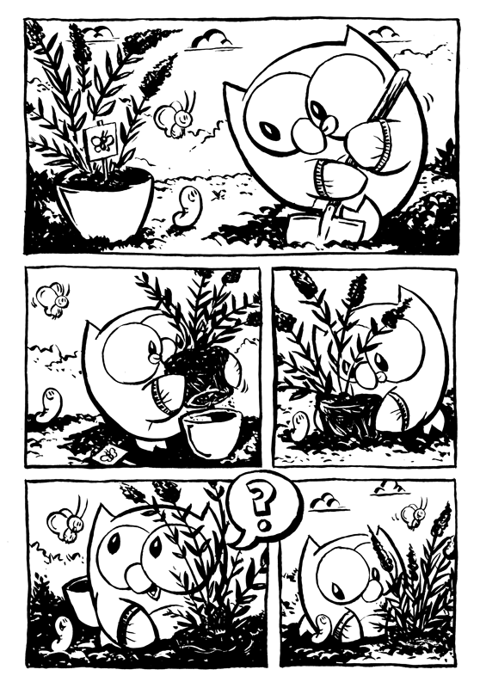

Slide 64
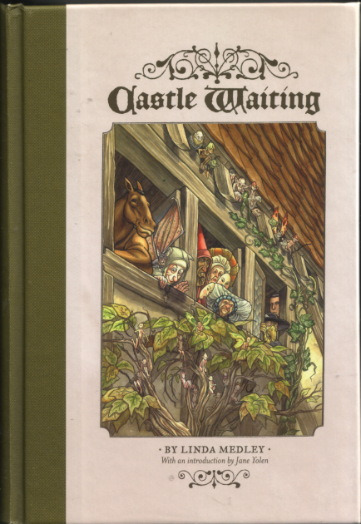
Notes:
Bringing the castle back to life and tying that to being a hero in your home

Slide 65
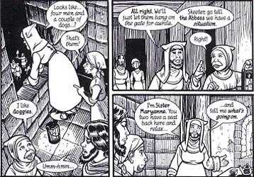

Slide 66
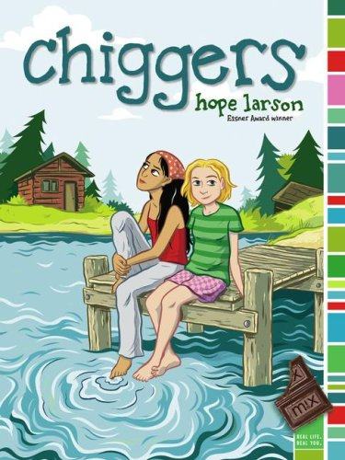
Notes:
Friedns at camp, friendship 6th grade
Hope larson

Slide 67
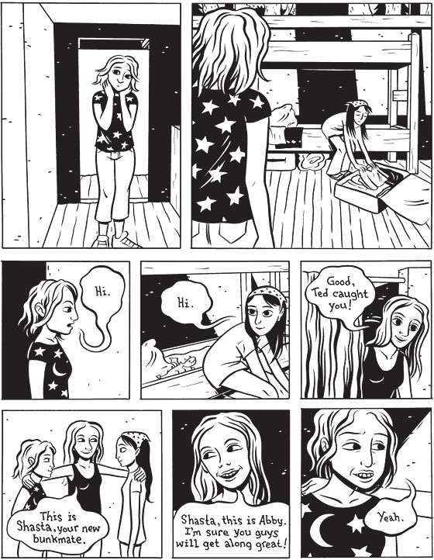

Slide 68
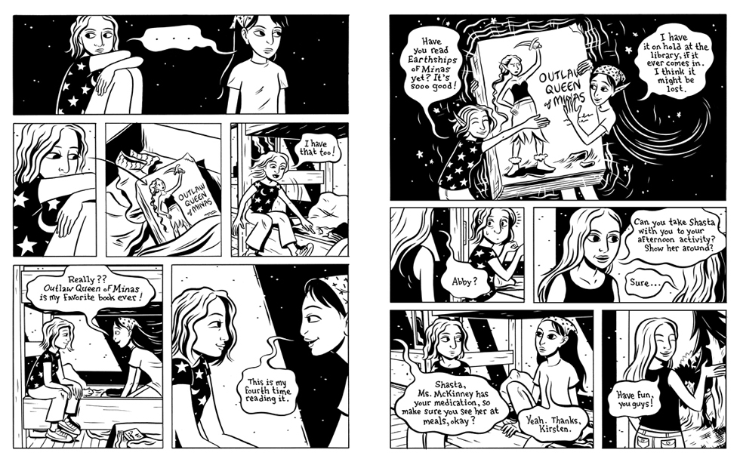

Slide 69
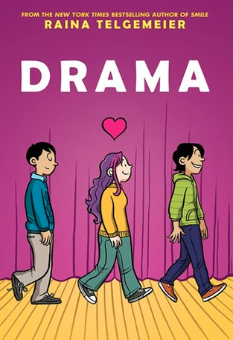
Notes:
Introduces a homosexual character

Slide 70
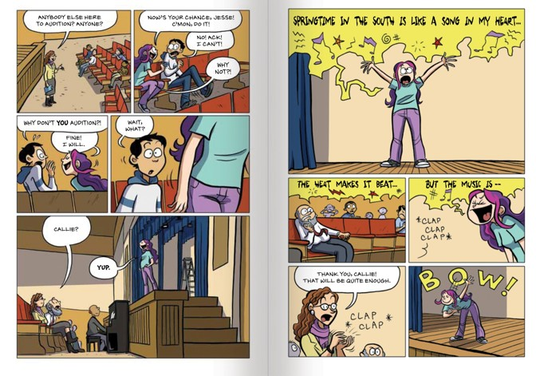

Slide 71
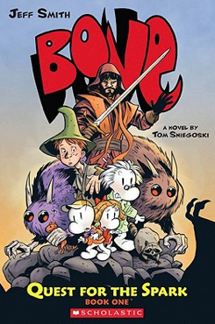

Slide 73
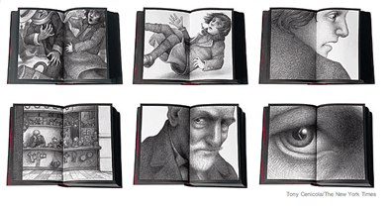

Slide 74
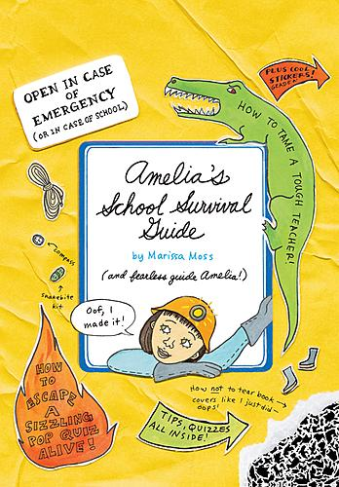

Slide 76
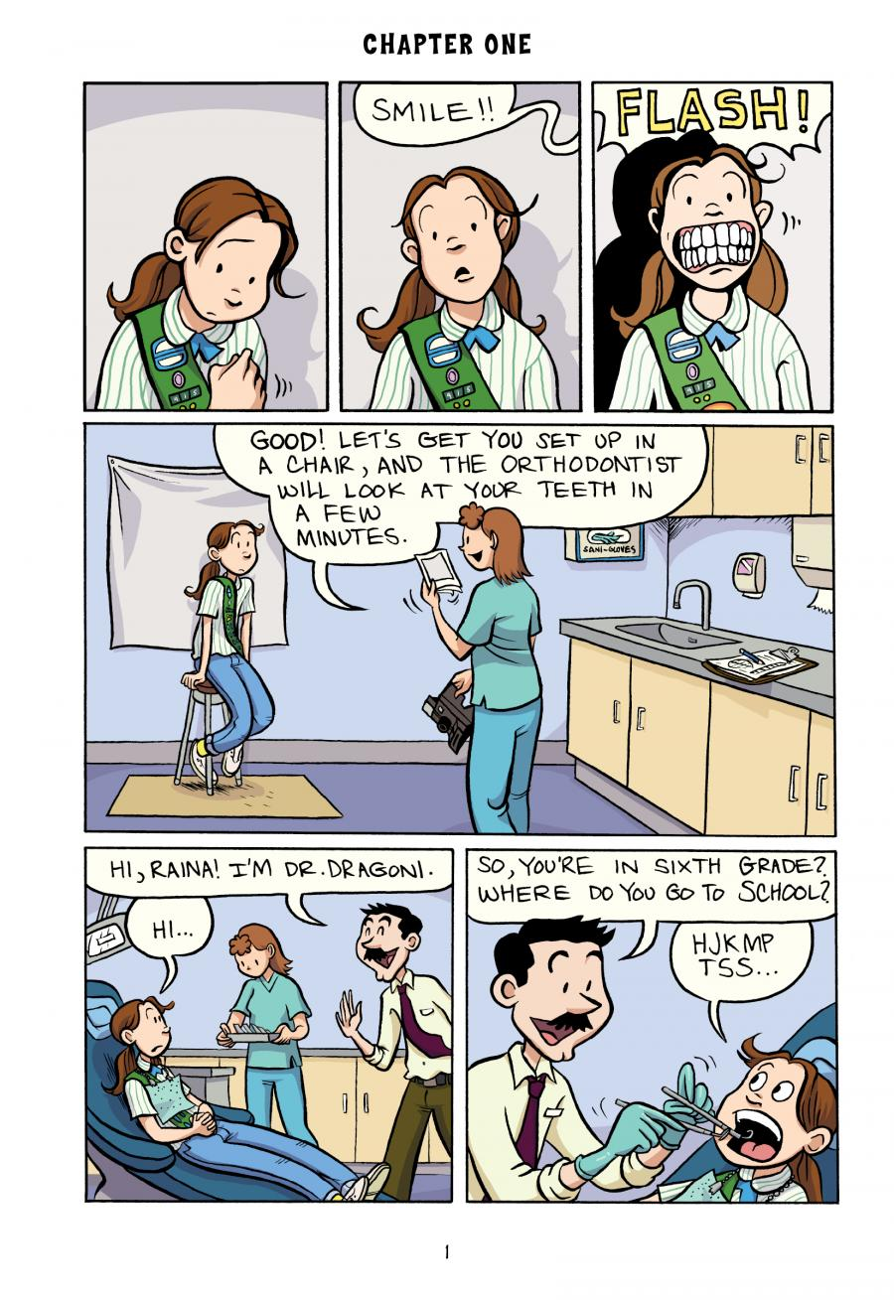

Slide 77
Notes:
A child’s story of the holocaust
acclaim

Slide 79
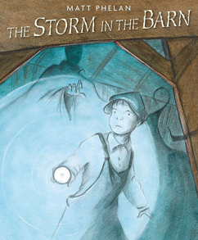
Notes:
Dust bowl

Slide 80
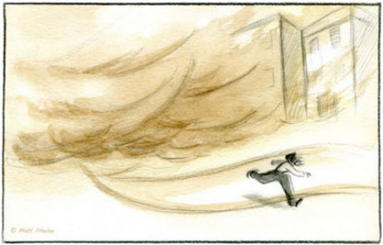

Slide 81
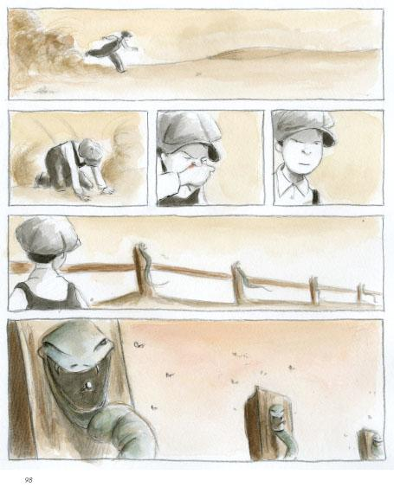

Slide 83
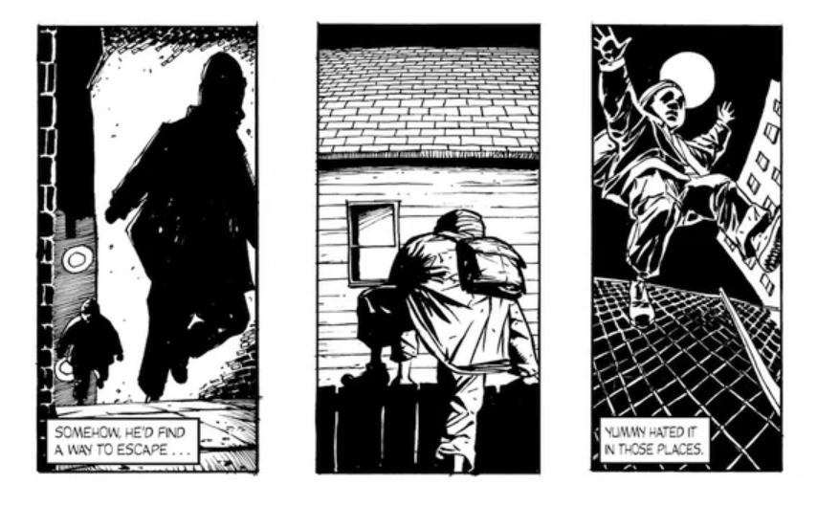

Slide 84
2011 Coretta Scott King Author Honor
2011 ALA Notable Book
2010 Cybil Award - Best YA Graphic Novel
2011 Once Upon a World Children's Book Award
2012 Street Lit Book Award - Emerging Classic
Publishers Weekly Best Books of 2010
Kirkus Reviews Best Books of 2010
Booklist Editor's Choice Best Books of 2010
2011 YALSA Top 10 Quick Picks
2011 ALA Great Graphic Novels for Teens
Booklist's Top 10 Graphic Novels for Youth
School Library Journal Best Comics for 2010
2011 CCBC Choices
2011 Storytelling World Honor Award
2011 IRA Notable Book for a Global Society
2011 Glyph Award finalist - Story of the Year
2011 Eisner Award finalist - Best Teen Book
SLJ's Fuse #8: 100 Magnificent Children’s Books of 2010 List
PW Comic Weekly Fifth Annual Critics Poll List
Chicago Public Library - Best of the Best Book
2011 Virginia, Indiana, and Louisiana Readers' Choice List for High School
2012 Maverick Graphic Novel List from the Texas Library Association
2010 Best Books for Youths (Philadelphia Inquirer, Times Union)
Top 5 Graphic Novels of 2010 (Guys Lit Wire, Nexus Graphica)
Cynsational Books of 2010
Notes:
Awards for Yummy

Slide 85
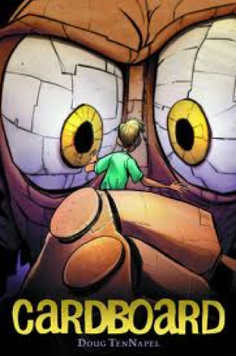
Notes:
A boy gets a cardboard box as a gift and magical things start happening

Slide 86
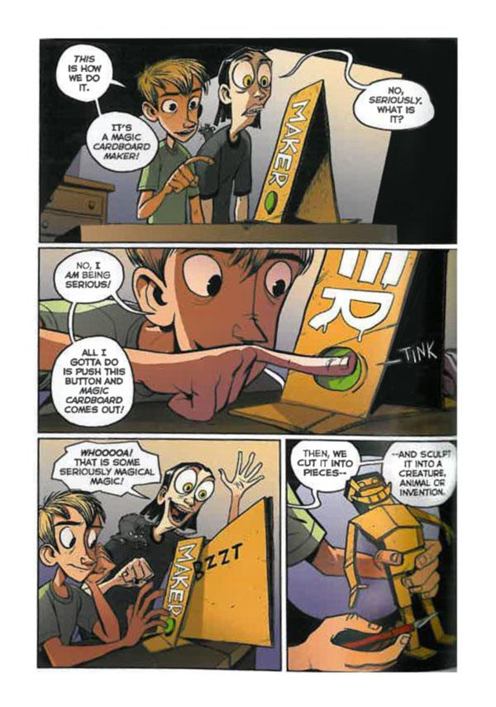

Slide 87
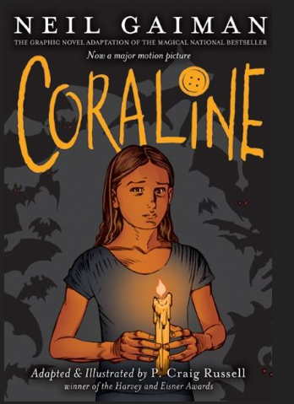

Slide 89
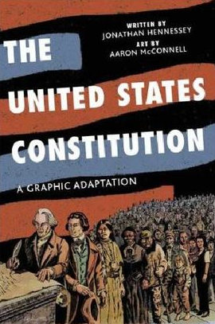

Slide 90
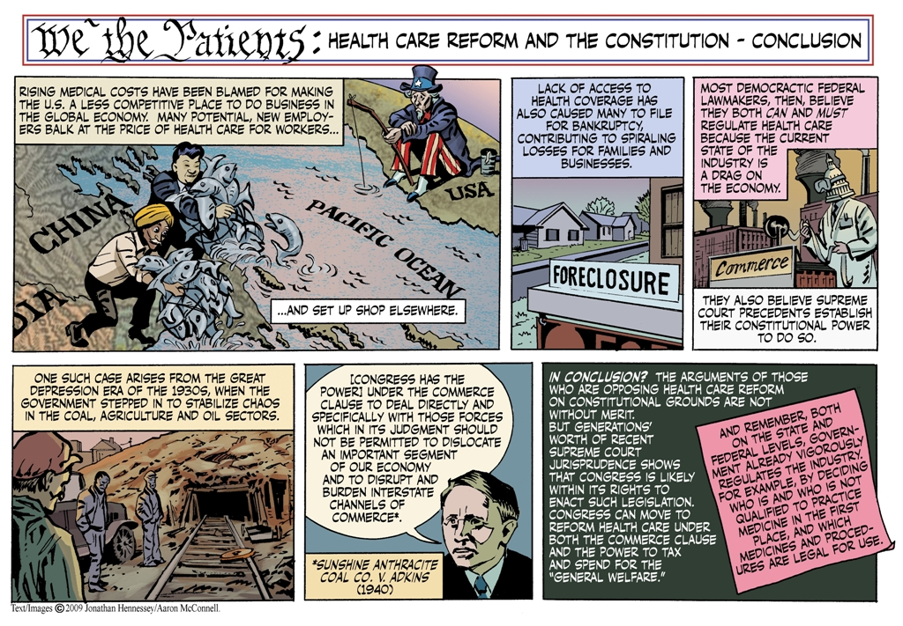

Slide 92
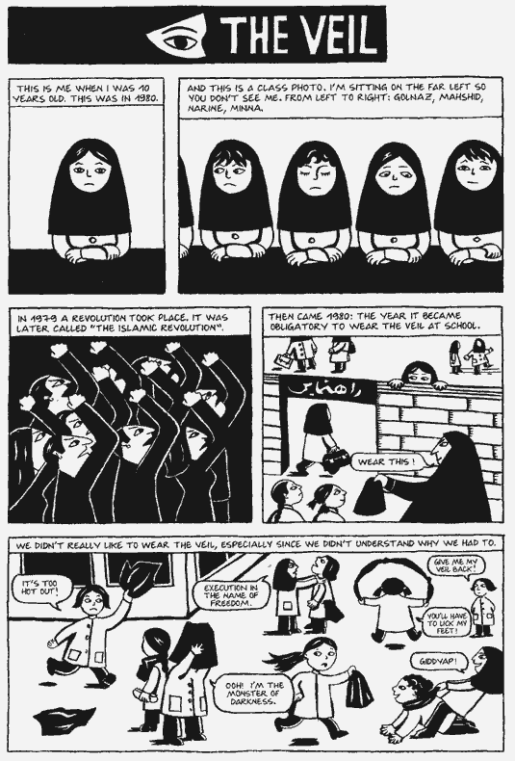
Notes:
Memoir of growing up in Iran duirng the time of the islamic revolustion
Award winning

Slide 93
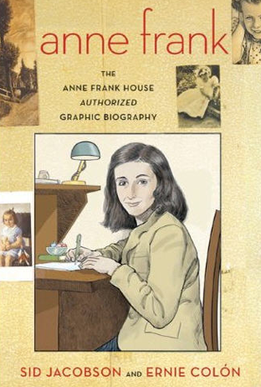

Slide 101
Notes:
Story of a Jewish survivor and his son

Slide 102
Notes:
Sci Fi

Slide 103
Notes:
The author was one of the few allowed to visit north korea in 2001 and this is the story of his visit in graphic form

Slide 105
Teaching Resources
http://cbldf.org/2013/06/using-graphic-novels-in-education-persepolis/
http://www.graphicnovelreporter.com
http://www.commonsensemedia.org/book-lists/graphic-novels
http://www.getgraphic.org/teachers.php
http://www.scholastic.com/teachers/lesson-plan/using-graphic-novels-children-and-teens-guide-teachers-and-librarians

Slide 106
Teaching Resources
http://blogs.slj.com/goodcomicsforkids/
http://www.ohiorc.org/adlit/InPerspective/Issue/2014-02.aspx
http://www.ala.org/alsc/graphicnovels2013
http://www.ala.org/alsc/graphicnovels2014
http://www.slj.com/2014/09/books-media/graphic-novels/the-graphic-advantage-teaching-with-graphic-novels/#_

Slide 107
Teaching Resources
http://www.ncte.org/magazine/archives/122031
http://www.readingwithpictures.org/2012/03/reading-lessons-graphic-novels-101/
http://www.makebeliefscomix.com/Comix/

Slide 108
Anita C. Gonzalez
The Ohio Resource Center
agonzalez@ohiorc.org

