Slide 1
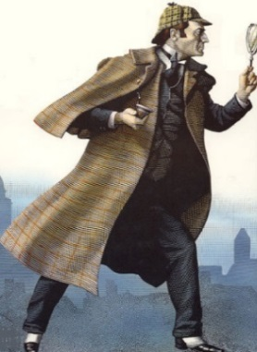
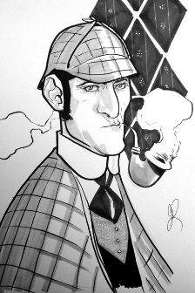
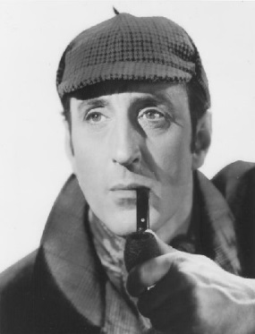
Sherlock Holmes: The History, The Influence, The Methods
(feat. Regina Stinson)
Thursday, October 2, 7:00 PM
Graubner Library
65821 Van Dyke
Washington, MI 48095
Sherlock Holmes: The History, The Influence, The Methods
(feat. Regina Stinson)
Thursday, October 2, 7:00 PM
Graubner Library
65821 Van Dyke
Washington, MI 48095
Sherlock Holmes: The History, The Influence, The Methods
(feat. Regina Stinson)
Thursday, October 2, 7:00 PM
Graubner Library
65821 Van Dyke
Washington, MI 48095
Notes:
To change this brochure, replace our sample content with your own. Or, if you'd rather start from a clean slate, press the New Slide button on the Home tab to insert a new page. Now enter your text and pictures in the empty placeholders. If you need more placeholders for titles, subtitles or body text, copy any of the existing placeholders, then drag the new one into place.
And did you notice we made fold marks for you? They are really light, but if you don’t like them showing on your brochure, select and delete them before you print.

