Slide 1
July 14, 2020
MI-SPI – Group Data Presentation
Cynthia Duchane
Andy Breeding
Senior Implementation Manager
Senior Product Manager

Slide 2
Agenda
Welcome and introduction
Data highlights
Walkthrough of MI-SPI data-set in GreenGlass
Next steps

Slide 3
Data highlights

Slide 4

OCLC number = 30399715
Harcourt Brace, 1994
A specific edition
Title Set
Baker College Michigan State Kettering University
Title Holding
Notes:
Just as a reminder when we say title-set, we’re talking about all the holdings in the group. We use the phrase title-holding, when we are talking about what is owned by one library.

Slide 5
MI-SPI Titles by the numbers
2.7M Works
3.0M Title-Sets (OCNs)
5.5M Title Holdings
5.9M Items
Per Title-Set Averages
1.8 Title Holdings
2.0 Items

Slide 6
Comparison with Earlier Rounds
 | MI-SPI 2012 | MI-SPI 2015 | MI-SPI 2019
# of libraries | 7 | 9 | 14
Title-Sets/ OCNs | 1.4M | 1.5M | 3M
Bib Records | 3.8M | 2.5M | 5.5M
Item Records | 4.2M | 2.6M | 5.9M
Notes:
Smaller in terms of overall bib and item count, but bigger in terms of unique title-count

Slide 7
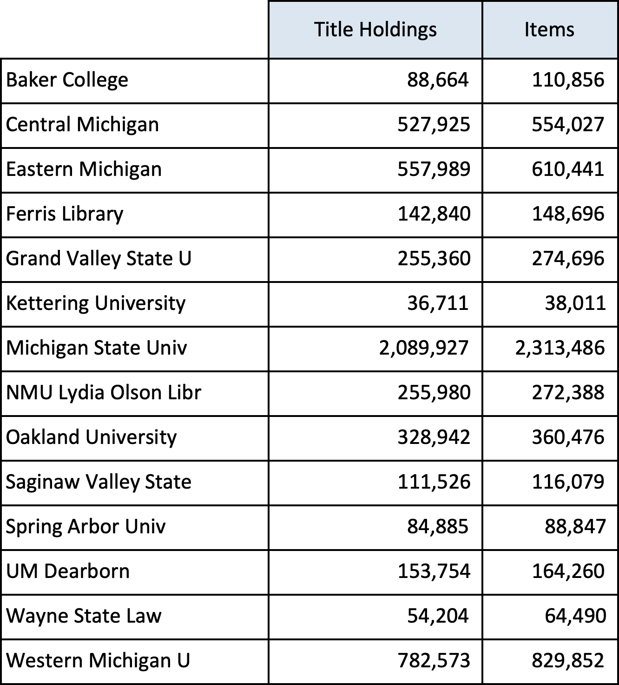
Title and Item Counts

Slide 8
MI-SPI Title Overlap – A First Look
 | Title-Sets | % | Title-Holdings | %
1 | 1,931,826 | 64% | 1,931,826 | 35%
2 | 503,269 | 17% | 1,006,538 | 18%
3 | 265,946 | 9% | 797,838 | 15%
4 | 153,394 | 5% | 613,576 | 11%
5 | 88,464 | 3% | 442,320 | 8%
6 | 49,658 | 2% | 297,948 | 5%
7 | 26,607 | 1% | 186,249 | 3%
8 | 12,927 | 0% | 103,416 | 2%
9 | 5,743 | 0% | 51,687 | 1%
10+ | 3,070 | 0% | 31,882 | 0%
Libraries Holding
“Scarcely Held”
< 3 holdings
81% of titles
53% of holdings
“Widely Held”
> 2 holdings
19% of titles
47% of holdings

Slide 9
Retentions
Notes:
Legacy retentions for libraries not participating in this round
Wayne State legacy retentions: 100K
Michigan Tech: 32K retentions

Slide 10
GreenGlass WALKTHROUGH
For a comprehensive series of GreenGlass
video tutorials go to:
https://www.oclc.org/en/greenglass/resources.html

Slide 11
NEXT STEPS

Slide 12
Your data is static. It’s a snapshot.
Avoid deaccessioning in-scope monographs
Avoid relocation projects related to monographs
Avoid major changes to the monographs collection
Until the MI-SPI 2.0 group is ready to move forward
in a coordinated way, all participants should
minimize changes to inventory!

Slide 13
Data Remediation Lists Available in GreenGlass
Records without OCLC numbers
WorldCat Title/Author Risk
Out-of-scope records
OCLC numbers assigned by SCS
Holdings not set in WorldCat
Multi-Edition Titles
Possible Duplicates

Slide 14
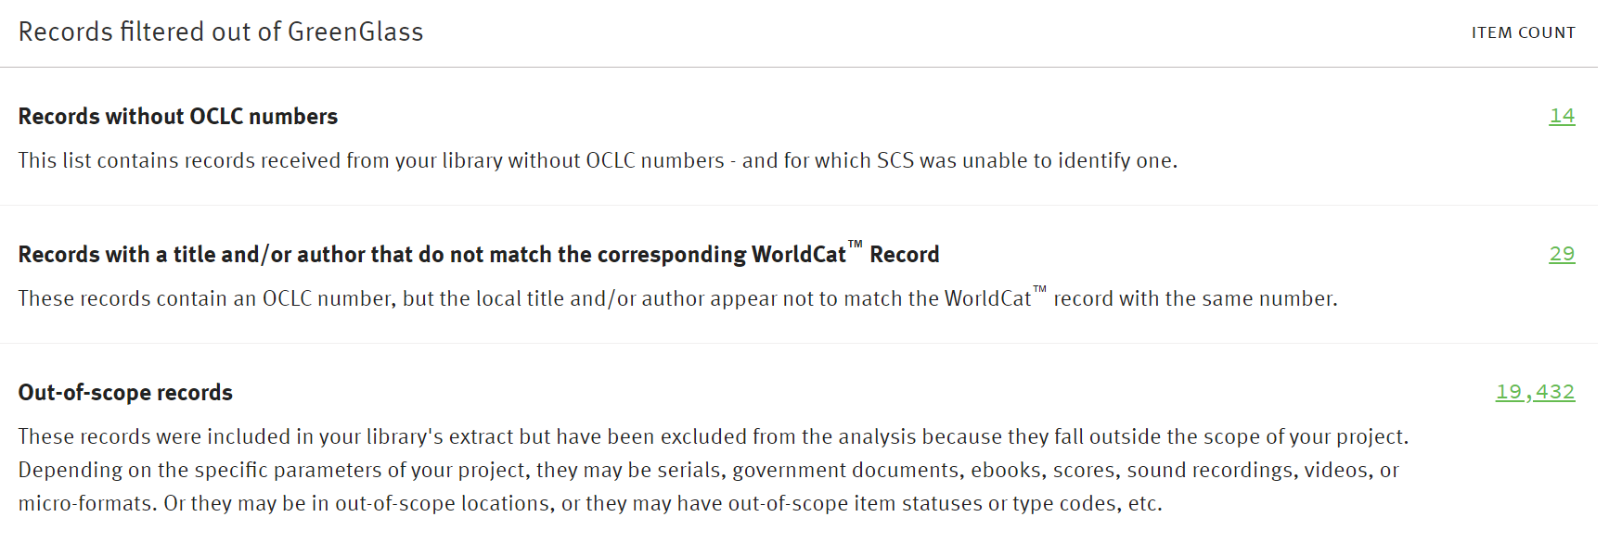
Records filtered out of GreenGlass
Example

Slide 15
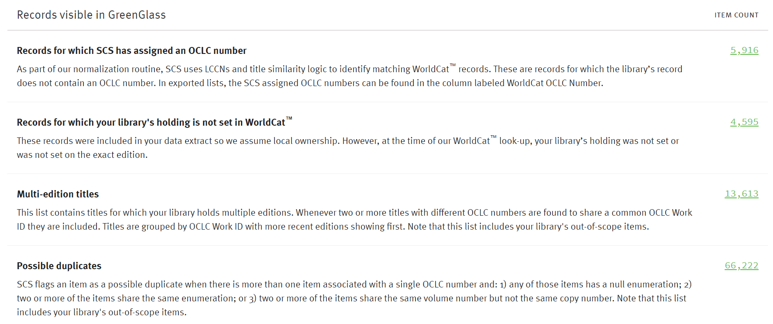
Records visible in GreenGlass
Example

Slide 16
For now, focus on:
Reviewing remediation lists in GreenGlass
  Report any questions or concerns regarding data to Cynthia and Stephanie as soon as possible. The earlier the better as any issues will need to be resolved before the retention model can be finalized.
Experimenting with group retention model builder
  Retention Model Builder (9 minutes)
  Successfully Implemented Retention Models (12 minutes)

Slide 17
Begin model discussions
What level of retention is each library comfortable with?
Are libraries with existing retentions willing to retain more titles?
If weeding is a goal for participant libraries, it will be important to retain some number of titles that are widely held.
Think about allocation considerations: Do you want to focus on allocating titles for retentions that are in storage units?
Notes:
Generic slide discussion notes:
it will be important to think ahead of time about a reasonable and responsible level of retention for each participant library and for the group as a whole. This percentage will become the target for your modeling exercises. You can tweak the thresholds of your retention model to approximate the retention percentage that is comfortable for the group.
Most groups choose to make retention commitments for a subset of the titles under analysis because it is overly burdensome to retain all. Very often, they commit to retaining scarcely held titles; defining ‘scarcely held’ in their own way, according to their own sensibilities.
If one of the goals of your shared-print project is to create safe weeding opportunities for members, it will be important to retain, within the group, some number of titles that are widely held. In this way, it will be possible for participants to identify surplus copies in their own collections, knowing that retained holdings in partner libraries will be accessible to their users for the duration of the commitment.
Many successful shared-print projects include collections that range in size from very small to very large. Even the smallest libraries can contribute their fair share to the protection of the collective collection.

Slide 18

Shared Print: Retention First!
Establish a safety net: ensure that content is secure
Group-wide agreement on retention model
Group-wide commitment to retention rules & duration
Secure scarcely-held titles within the group
Secure sufficient holdings to satisfy likely user demand
Share responsibility for retention proportionately
Deselection only after retention commitments established

Slide 19
NEXT STEPS
MI-SPI: Develop retention scenarios & decide on retention model
SCS: Allocate retentions and reload GreenGlass w/retentions
MI-SPI: Review (and as needed) reject retentions (optional)
SCS: Remove rejected retentions and reload GreenGlass
MI-SPI: Individual libraries begin deselecting titles as needed
MI-SPI: Retention disclosure, WorldCat registration

Slide 20
Questions?
Cynthia Duchane
duchanec@oclc.org
Andy Breeding
breedina@oclc.org

